Slide 1
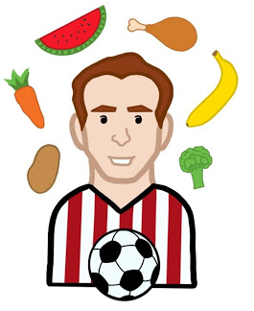
Sir Stanley’s Well
Rounded Adventure
SENIOR DESIGN AY 2019-20
Notes:
Brooke
Hi everyone, welcome to our Senior Design Presentation. Over the past 2 semesters we have been working hard with our client Professor Samantha Davis, on a mobile game called Sir Stanley’s Well Rounded Adventure. Before we introduce our project, first we are going to introduce ourselves.

Slide 2
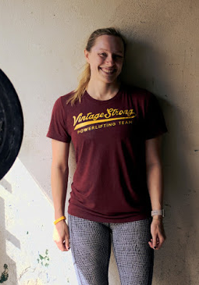
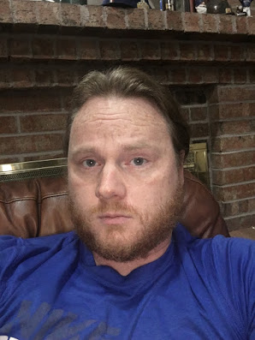
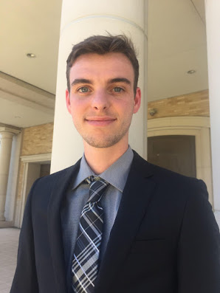
Team Members
Brooke Smith – COSC – Team Lead
David Rasberry – CITE – Website Manager & Tester
Shane Mitchell – CITE – Artist/Programmer
Notes:
Everyone introduces themselves

Slide 3
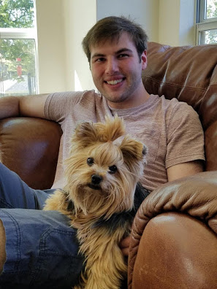
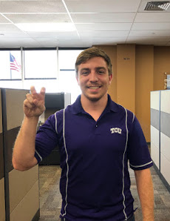
Team Members
Nick Bonavia – COSC – Programmer
Sellars Levy – COSC – Programmer
Westen Riley – COSC - Programmer
Notes:
Everyone

Slide 4
Outline
Our Client
The Problem
The Goal
Our Solution
Demo
What We Learned
Notes:
David/Shane
So here is the outline to our presentation:
first we will talk about our client
then the problem we are trying to help and our overall goal with this project
after that we will talk about our solution
then we will end with a demo of our game and some final thoughts

Slide 5
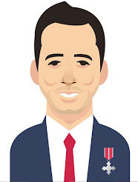
Our Client
Professor Samantha Davis
Associate Professor in the Department of Nutritional Sciences
Works with Sir Stanley Matthews Coaching Foundation
Sir Stanley Matthews Coaching Foundation
Giving opportunities to kids to play sports
Inspiring kids to to be active and healthy
Want our app to be part of their Succeed with Stan Campaign
Notes:
David/Sellars
Our client is professor samantha davis and she is an associate professor over in the nutrition department. She works with sir stanley matthews coaching foundation which focuses on giving kids the opportunity to play sports, and inspires kids to be active and healthy. Our app is going to be part of their Succeed with Stan Campaign.

Slide 6
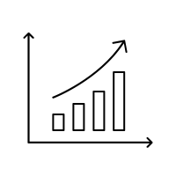
The Problem (Big Picture)
Childhood Obesity rates are increasing
Children lack knowledge for living a healthy lifestyle
Children are less active now than previous generations
How can we help as software engineers?
Notes:
David/Westen
The big picture issue that we are trying to help solve is childhood obesity. Children lack the knowledge for living and healthy lifestyle and are less active now than in previous years. But we are only software engineers, so how can we help?

Slide 7
The Goal
Ultimately we are trying to help fight the childhood obesity epidemic. We want to:
Educate children on topics like nutrition and physical activity
Create a mobile game that is entertaining for kids who are 6-11 years old
Encourage kids to get active and to make well informed choices when it comes to their nutrition
Notes:
David/Nick
Since childhood obesity is a larger scale problem, here is a small outline of our goals. We hope to help educate children on topics like nutrition and physical activity. We also want our mobile game that is engaging and entertaining for kids around 6-11 years old. Finally, we are trying to encourage kids to get active and make well informed choices when it comes to their nutrition.
Now Brooke will explain how Sir Stanley’s Well Rounded Adventure got to where it is today.

Slide 8
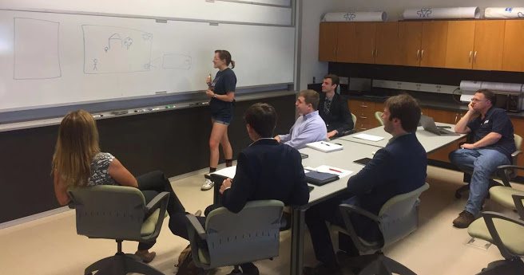
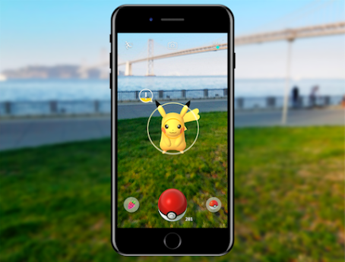
Our Solution: Initial Ideas
Food and activity tracking
Something similar to Pokemon-Go
RPG (role playing game) with quests, lots of dialog, and many characters
Notes:
Brooke
The first step to building our app was to design the game and to think of how we could provide educational content for kids while also keeping them engaged.
The initial plan started with an activity/food tracker that would give the players points for eating healthy foods and doing simple exercises. We decided that this might not be engaging enough for the younger audience.
We also briefly thought about making something similar to Pokemon Go, where kids could walk around outside and find virtual fruits and vegetables, but we decided it might be too dangerous for young kids.
Finally, we discussed an RPG (role playing game) style of game. THis would involve lots of quests, story, and dialog. We decided to avoid this option because we are not creative writers and we wanted to focus more on teaching distinct topics through a series of minigames.

Slide 9
Our Solution: Sir Stanley’s Well Rounded Adventure
Our final decision:
Several fun mini-games focused on specific topics relating to nutrition or physical activity
Tutorials will focus both on how to play the minigames and how the information applies to the player’s real life
Achievement system that will motivate players to play the minigames more than once
Tips that will include real life examples of healthy meals
Notes:
Brooke
Decided on a “Game of mini-games”
Each minigame is focused on a specific topic relating to nutrition or physical activity (such as macro nutrients, how much water you should drink when you workout, etc) These topics will be taught through the tutorials that are displayed before each game.
Each minigame also has achievements associated with them to motivate players to keep playing the minigames and to reinforce the information they have learned.
Finally, there is a “tips” menu in the game where the players can learn more about specific topics. All of the information was brought to us by the wonderful students in the nutrition department!

Slide 10
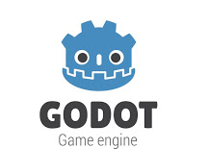
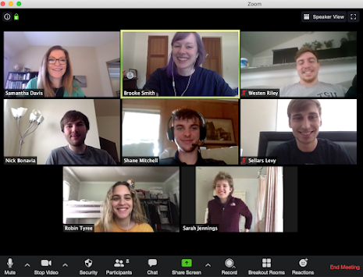
Our Solution: Technologies
GODOT - Free, open source, game engine
It can produce applications that can run on both iOS and Android
GDScript - Godots built in language (similar to Python)
JSON
GIT
Monday.com
Slack
Zoom
Procreate for the iPad
Notes:
Sellars
Godot is a free, open source, game engine with its own Python-like language GDScript
JSON files for saving
Git/Github for sharing
Monday.com for tracking our progress
Slack and Zoom for online communication
Brooke and Shane used Procreate for the iPad for our art
Our app will be built in a free, versatile game engine call GODOT. GODOT has an excellent 2d engine that will help us build Sir Stanley's Well Rounded Adventure with ease. It also has to capability to export iOS and Android apps so that no matter if the kid or their parents have iPhone or Android, they will not miss out on our game.
We used a variety of technologies for our project. For development, we used GODOT. It is a free and versatile, cross-platform game engine with its own Python-like scripting language called GDScript making it easy to learn. GODOT is able to read and write from json files which we used for saving and loading data. For version control, we used github and monday.com for task management. we communicated using slack and zoom. And used Procreate on the iPad for graphic design.

Slide 11
Title Screen: Play
Notes:
Nick
Now we are going to demo Sir Stanley’s Well Rounded Adventure. This is our title screen.

Slide 12
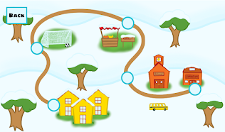
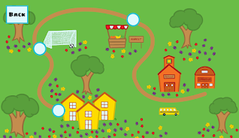
Play/Map Screen
Two seasons
First Season(Winter) easy difficulty
Second Season(Spring) harder difficulty
Minigames located on map screen
Various locations
Soccer field
Food market
Recreation center
Notes:
Nick

Slide 13
Our Minigames
Stan’s Snacks - A game about fruits vs. vegetables and macronutrients
Falling Food - A game about eating balanced meals
Goalie Shootout - A game about physical activity
Goalie Defender - Another game about physical activity
Color Categories - A game about vitamins, and the importance of eating a variety of colorful vegetables and fruits
Notes:
Nick

Slide 14
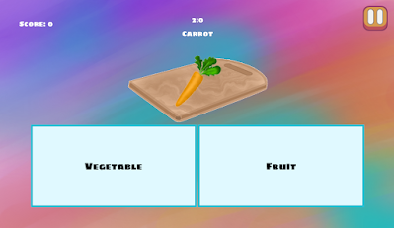
Stan’s Snacks
Stan’s snacks is one of the 5 base minigames, it has two level difficulties
Goal - educate players on the categories and properties of various foods
Level 1 - select whether the displayed food is either a fruit or vegetable
Level 2 - select which macronutrient is highest in the displayed food.
Notes:
Shane
Level 1
Level 2
Challenges:
some food classifications are not universally accepted
user experience
some foods are very close in macro percentages

Slide 15
Stan’s Snacks Demo
video here
Notes:
Shane

Slide 16
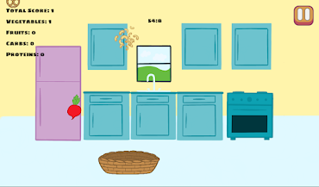
Falling Foods
Food is falling, and you must catch the food items to build a balanced meal!
Goal - Educate players on building a healthy and balanced meal
Level 1 - Try to catch as many foods as possible, learn the different macronutrients and groupings of these foods
Level 2 - Catch a balanced meal (one of each type in any order) to gain a multiplier bonus to your score
Challenges
Designing mechanism for loading in food types
Tracking when a player starts to catch a“balanced meal”
Notes:
Brooke
Our next game is called Falling Foods. In this minigame, foods are falling from the top of the screen and the player must catch the foods to build a balanced meal. Our goal for this minigame is to teach kids about building healthy meals as well as to teach them the basic grouping of these foods.
In the first level, the player focuses on catching as many foods as possible while learning which of those foods is a protein, carb, fruit, and vegetable. The second level focuses on catching a balanced meal, so the player will get a multiplier applied to their score whenever they build a balanced meal consisting of 1 carb, 1 protein, 1 fruit, and 1 vegetable in any order, but without any duplicates. This was probably the most challenging part of the game to develop because it requires some tricky logic.

Slide 17
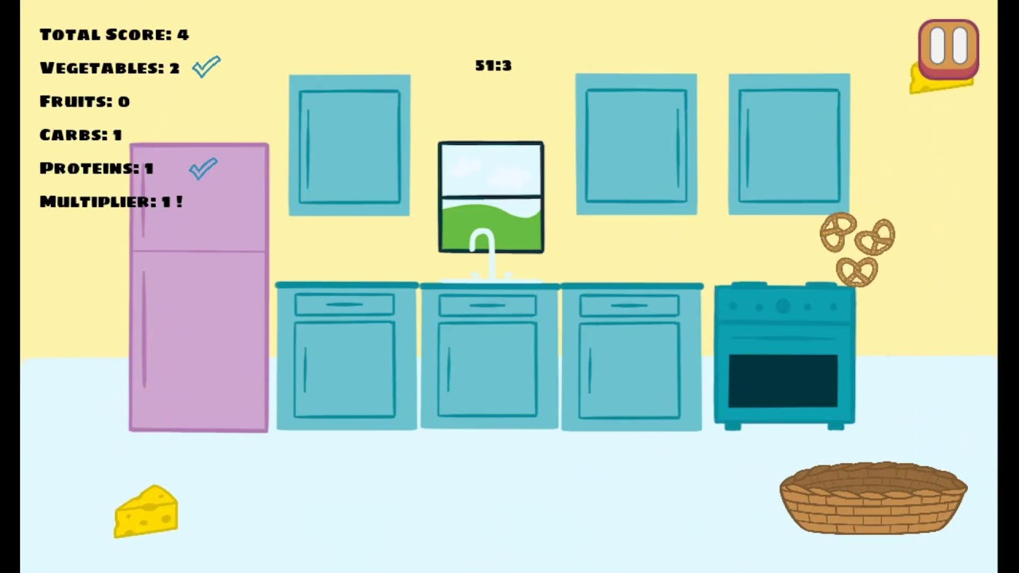
Falling Food Demo
video here
Notes:
Brooke
In the first level, the player focuses on catching as many foods as possible while learning which of those foods is a protein, carb, fruit, and vegetable.
Tap the screen to move the basket
as the player catches the food, they get a point to their overall score as well as one to the specific food group
The second level focuses on catching a balanced meal, so the player will get a multiplier applied to their score whenever they build a balanced meal consisting of 1 carb, 1 protein, 1 fruit, and 1 vegetable in any order, but without any duplicates. This was probably the most challenging part of the game to develop because it requires some tricky logic.
Physics
Art

Slide 18
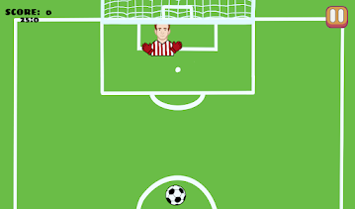
Goalie Shootout
Goalie Shootout is a minigame that where the player tries to score as many goals as they can in the amount of time given.
Goal - Educate players on ways to get active and have fun.
Level 1 & 2 - Level one features one goalie and level two features a goalie and a extra defender.
Challenges - Developing a fun game that will educate the player about physical activity.
Notes:
Westen
Goalie Shootout is a minigame where the player tries to score as many goals as possible in 30 seconds. The goal for this game was to educate the players in a fun way about physical activity and being healthy. Goalie Shootout features two levels with the first one having only a goalie and the second level having a goalie and a extra defender. This is to show that we can scale the games to become more difficult if we were to expand the game. - next slide

Slide 19
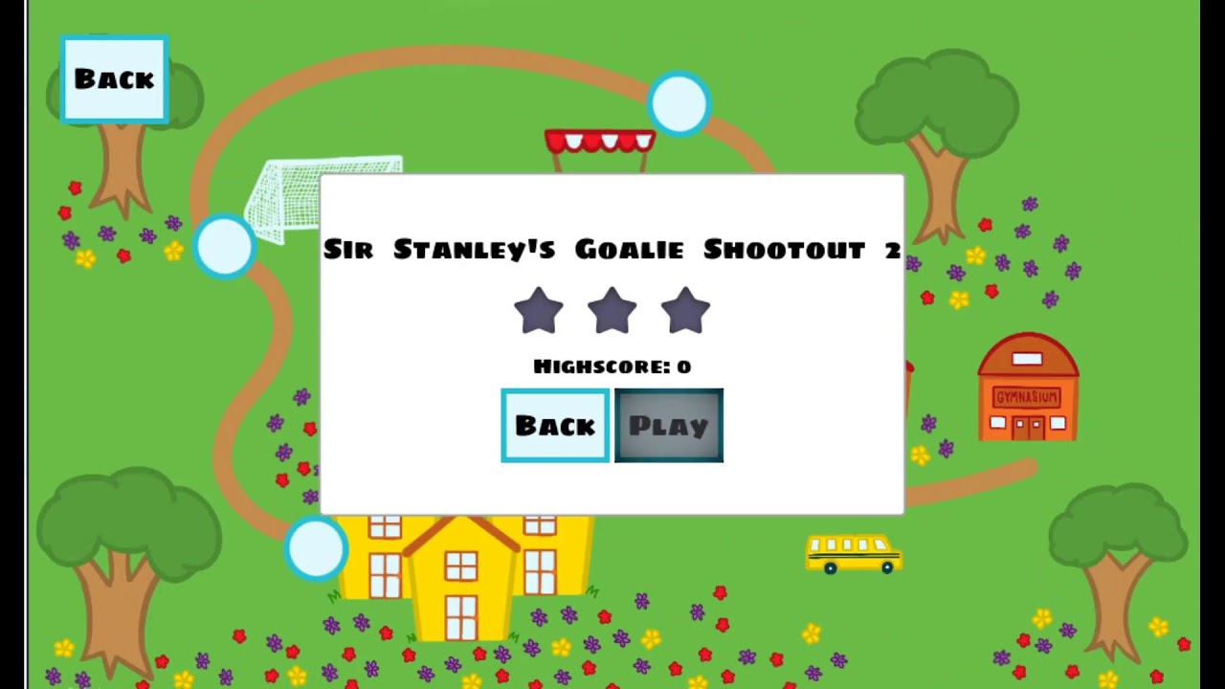
Goalie Shootout Demo
video here
Notes:
Westen
As you can see like the previous games we discussed, we have the tutorial screen which talks about how to play the game as well as why it is important for young kids to get outside and be active and healthy. The goal is to score as many goals as possible in 30 seconds while avoiding the goalie from blocking your kick. -pause- One of the main reasons we made this mini-game was because Sir Stanley Matthew - the founder of the Sir Stanley Matthews foundation - was a famous english soccer player who is often regarded as one of the greatest players of the game and the only player to be knighted. -pause for second minigame- Now we are moving to the second level of goalie shootout which again has the tutorial screen explaining why it is important to get exercise and go outside. This time you can see we have two defenders blocking the ball to show that we can add more and more challenges to these minigames to make them harder and more exciting for the players.

Slide 20
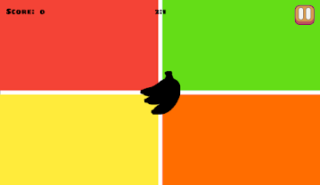
Color Categories
Color Categories is a minigame designed to teach children about how certain nutrients can be associated with the color of the fruit/vegetable.
Goal - Educate players on the relationship between nutrients and colors
Challenges
Selecting foods with consistent colors/nutrient matches so as not to confuse the children
Notes:
Sellars
Color Categories is a quiz type matching game, similar to Stan’s snacks, where the player must select the color that corresponds with the blacked out image of a fruit or vegetable. The goal of the game is to teach the player about the relationship between the color of a fruit/vegetable and what nutrients/vitamins it contains that is giving it this color. The main challenge with this game was that some foods can have different colors that doesn’t always relate to the “main” vitamin/nutrient but this was solved by using the most common form.
.

Slide 21
Color Categories
video here
Notes:
Sellars

Slide 22
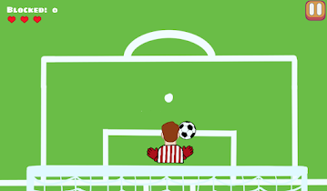
Goalie Defender
Goalie Defender is a minigame where the player acts as the defender and tries to block as many goals as possible.
Goal - Educate players on ways to get active and have fun.
This minigame plays as the opposite of goalie shootout to show that there are many different ways to get active and be healthy.
Challenges - There were a significant amount of bugs that had to be fixed so this minigame ran nicely.
Notes:
Westen
Goalie Defender is a minigame that is the opposite of the game I talked about earlier - goalie shootout. The goal for this game is to block as many shots as possible before you lose all three hearts. Again this game was to educate the player about being active and healthy by getting outside and having fun. - next slide

Slide 23
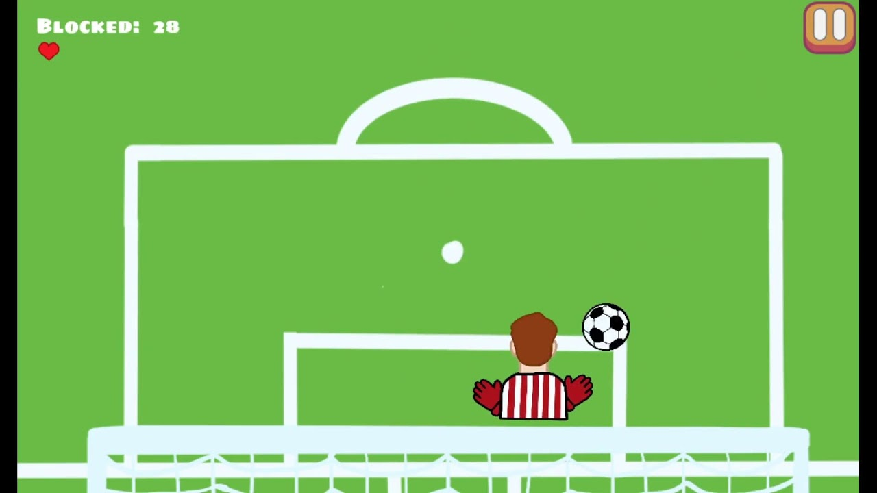
Goalie Defender Demo
video here
Notes:
Westen
Again, like in all of the other minigames we can see the tutorial talking about how to play goalie defender and more bits about why its good to go outside and exercise. As the game starts we can see that the player uses their finger to drag the defender left and right to block all of the shots. So the player wants to block as many shots as they can before they lose all three hearts. And as we see them slowly lose hearts - once the last one is gone, the game is over. Because in this playthrough they got less than the best amount of blocks they will only get two stars - next slide.

Slide 24
Title Screen: Achievements
Notes:
Nick
Now we are back at the Title Screen, where we can head to the achievements screen and Sellars will show us around

Slide 25
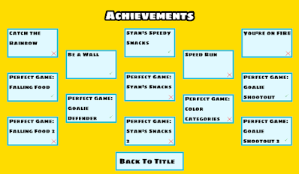
Achievements
The Achievements Page can be reached from the Title Screen. They provide “accomplishments” to encourage the child to play more.
Displays name of achievement and if unlocked
Once clicked,
Shows full description of achievement
Notes:
Sellars

Slide 26
Achievements
video here
Notes:
Sellars

Slide 27
Title Screen: Tips
Notes:
Nick
Now we are back at the Title Screen, where we can head to the Tips screen

Slide 28
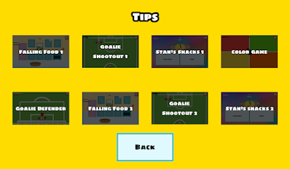
Tips
The Tips screen can be found on the Main menu of the game. Here you’ll find all sorts of useful health and nutrition facts and information.
Categorized by relation to minigame
Foods to eat when you’re playing sports e.g. Football/Soccer
Displays preview of minigame
Further reinforces connection between activities nutrition
Notes:
Nick

Slide 29
Tips
video here
Notes:
Nick

Slide 30
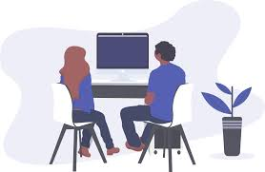
Challenges/What We Learned
GitHub
.import files
Merging - some conflicts were not being shown (.tscn files)
Godot
Not much experience - Pair programming and show and tell
Some discrete bugs with the engine made for some big problems
Resources
We ended up making our own art for style consistency
Music/sound and understanding the licencing
Notes:
Shane
Our main challenges:
Github: It can be hard to track changes in godot because there are scripts (the programming part) as well as scenes. We had some issues early on with some conflicts from the scene files not being shown when trying to merge.
We also initially started with a branch for every minigame, which seemed reasonable at first, but we later realized this was a mistake. Going forward, we will be having a branch for each minigame and then a branch within that branch for each team member working on that minigame.
Our other challenge was that we are all new to using Godot. We solved this by using pair programming to ensure that no one got stuck for too long, and we did a lot of “show and tell”. For an example, Westen developed the soccer game’s scoring system and Nick and I used it as an example for another minigame’s scoring system.

Slide 31
What We Learned
How to develop a game using Godot and GDScript
Structuring scene hierarchies through canvas layers
Using signals for event handling
How to use GitHub in a team project by managing branches and merges
Game design, splitting the work into decoupled parts
Consistent style for the art
How to communicate with different people from different fields
How to work as a team to find solutions to problems and to use our strengths to help where others are struggling.
Notes:
Westen

Slide 32
Future Plans
Handing the project off to TCU
Possibility of furthering development in future semesters.
Eventual hope is to have it published on app store and Google Play store
Pilot the application to schools associated with Sir Stanley Matthews Coaching Foundation
Notes:
Shane
So for iteration 2:
Polishing our current minigames: this means adding in better art, animations, improving the scoring system, and adding in save-data
In the spring we will be working on more minigames, extra levels of difficulty for our current minigames, the sound and music, as well as adding save-data so that the game will save the player’s high-score

Slide 33
Acknowledgements
Professor Davis and her nutrition students
TCU CS Department
Dr. Scherger and Dr. Wei
Notes:
So finally we would like to say thank you to a few people. First, we would like to thank our client Professor Davis for giving us this awesome and unique learning opportunity and trusting us with this project. We would also like to thank her nutrition students who helped a lot with both the brainstorming and the content of all of the minigames. Of course, we would like to thank the TCU CS department for helping us get to this point. Finally, we would like to thank Dr. Scherger and Dr. Wei for guiding us through this project. this was the first video game project that Senior Design has done, so it was a learning experience for everyone, but I think I speak for my whole team when I say that we learned a lot and had a lot of fun on this project.

